Slide 1
NETWORK COMPONENTS

Slide 2
Basic Network Components
Client
Server
Network Interface card
Cables
Modems
Hub
Switch
Router

Slide 3
Functions of network devices
Separating (connecting) networks or expanding network
  e.g. repeaters, hubs, bridges, routers, brouters, switches, gateways
Remote access
  e.g. 56K Modems and Asymmetric Digital Subscriber Line (ADSL) modems

Slide 4
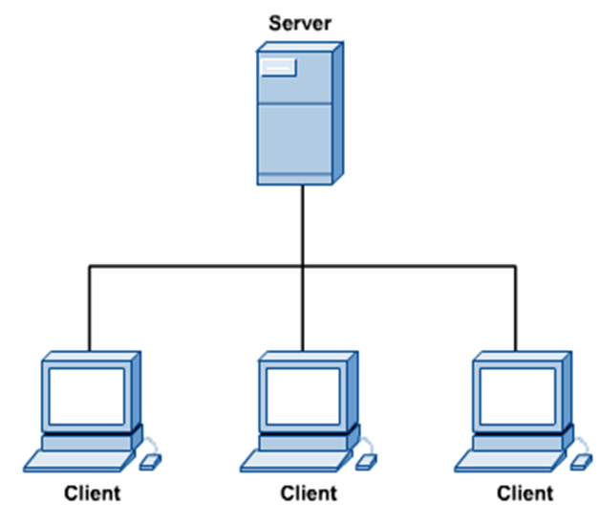
Clients and Servers
In a client/server network arrangement, network services are located in a dedicated computer whose only function is to respond to the requests of clients.
The server contains the file, print, application, security, and other services in a central computer that is continuously available to respond to client requests.

Slide 5
Network Adapters
Also called network interface cards (NICs)
  Connects node to the media - Connectivity devices enabling a workstation, server, printer, or other node to receive and transmit data over the network media
In most modern network devices, network adapters contain the data transceiver ( Formats, send and receive)
Unique Machine Access Code (MAC)

Slide 6
Types of Network Adapters
For a desktop or Power PC, network adapter is likely to be a type of expansion board
  Expansion boards connect to the system board through expansion slots
The circuit used by the system board to transmit data to the computer’s components is the computer’s bus

Slide 7
Types of Network Adapters
PCMIA (Personal Computer Memory Card International Association)
  Developed in early 1990s to provide standard interface for connecting any type of device to a portable computer
  More commonly known as PC Cards
USB (Universal Serial Bus) port
  Standard external bus that can be used to connect multiple types of peripherals
A parallel port network adapter
Wireless network adapters
A variety of Ethernet network adapters

Slide 8
Cables
Network linking devices
  Connect nodes in the network
  Cable runs from node to device
  Crossover cable connects two computers

Slide 9
Modems
Modulator/demodulator
It is a device normally provided by the Internet Service Provider (ISP) to gain access to the Internet.
It converts analog and digital signals between the landline and the Internet.

Slide 11
Connecting Devices and
the OSI Model

Slide 12
Repeaters
A repeater is a device that receives a weak or corrupted signal, cleans and regenerates it, and retransmits it.
It typically consists of a receiver to capture signals, a signal processor (or filter) to clean noise, an amplifier to boost signal power, and a transmitter to send the signal further
A repeater operates at the physical layer. Its task is to regenerate the signal over the same network before the signal becomes too weak or corrupted.
A repeater is a regenerator, not an amplifier.
When the signal becomes weak, they copy the signal bit by bit and regenerate it at the original strength.
It is 2 port device.
Use no logic in regenerating signals, thus data and noise are both regenerated by the repeater.
Can be used to extend the range of a single LAN.

Slide 13
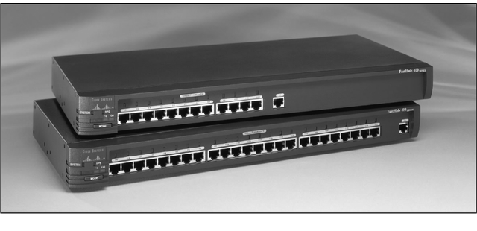

Slide 14
Repeater and OSI Model

Slide 15
A Repeater

Slide 16
Function of a Repeater

Slide 17
Repeaters
Traditionally, any discussion of networking components would include repeaters, but today repeaters are a little outdated.
Repeaters were once used to increase the usable length of the cable, and they were most commonly associated with coaxial network configurations.
Because coaxial networks have now fallen out of favor, and because the functionality of repeaters has been built in to other devices, such as hubs and switches, repeaters are rarely used.

Slide 18
A network hub is a basic hardware device that connects multiple computers or devices in a Local Area Network (LAN). i.e. It is a network interconnection device with multiple interfaces that accepts an incoming signal from an interface and repeats it onto all other interfaces.
It operates as a central connection point but is considered "unintelligent" because it simply broadcasts incoming data to all connected devices, rather than sending it only to the intended recipient

Slide 19
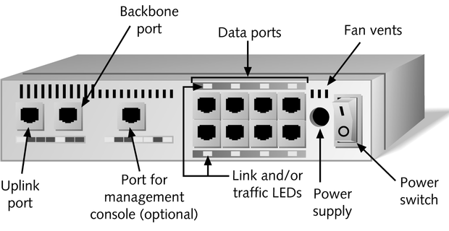
Hubs

Slide 20
Multiport repeater containing multiple ports to interconnect multiple devices
Physically, hubs are:
  Small electronic devices.
  Have connections for several computers (e.g., 4, 8, or 20).
Logically, hubs:
  Operate only on signals.
  Propagate each incoming signal to all connections.
  Are similar to connecting segments with repeaters.
  Do not understand frames (Layer 2 packets) so cannot filter them.

Slide 21
Hubs are simple network devices, and their simplicity is reflected in their low cost
Computers connect to a hub via a length of twisted-pair cabling.
In addition to ports for connecting computers, even an inexpensive hub generally has a port designated as an uplink port that enables the hub to be connected to another hub to create larger networks.

Slide 22
Most hubs are referred to as either active or passive.
Active regenerate a signal before forwarding it to all the ports on the device and requires a power supply. Small workgroup hubs normally use an external power adapter, but on larger units the power supply is built in.
Passive hubs, which today are seen only on older networks, do not need power and they don’t regenerate the data signal.

Slide 23
Hubs
Intelligent hubs
  Possesses processing capabilities
Standalone Hubs
  Hubs that serve a group of computers that are isolated from the rest of the network
    Best suited to small, independent departments, home offices, or test lab environments
  Disadvantage to using a single hub for many connection ports is that it introduces a single point of failure on the network
Stackable Hubs
  Physically designed to be linked with other hubs in a single telecommunications closet

Slide 24
The basic function of a hub is to take data from one of the connected devices and forward it to all the other ports on the hub.
This method of operation is inefficient because, in most cases, the data is intended for only one of the connected devices.
Due to the inefficiencies of the hub system and the constantly increasing demand for more bandwidth, hubs are slowly but surely being replaced with switches.

Slide 25
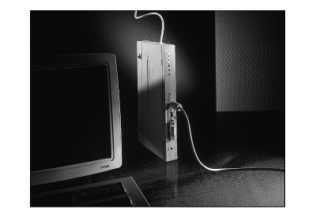
Bridges
Like a repeater, a bridge has a single input and single output port
Unlike a repeater, it can interpret the data it retransmits

Slide 26
Bridges
A bridge (or bridge-like device) can be used to connect two similar LANs, such as two CSMA/CD LANs.
A bridge can also be used to connect two closely similar LANs, such as a CSMA/CD LAN and a token ring LAN.
The bridge examines the destination address in a frame and either forwards this frame onto the next LAN or does not.
The bridge examines the source address in a frame and places this address in a routing table, to be used for future routing decisions.

Slide 27
Bridge and the OSI Model

Slide 28
A Bridge

Slide 29
Function of a Bridge

Slide 30
Types of Bridges
Transparent
  Basic Bridge
  Learning Bridge
  Spanning Tree Bridge
Translational bridge
Source-routing Bridge
Remote Bridge

Slide 31
Transparent Basic Bridge
A transparent bridge does not need programming but observes all traffic and builds routing tables from this observation called backward learning.
Each bridge has two connections (ports) and there is a routing table associated with each port.
A bridge observes each frame that arrives at a port, extracts the source address from the frame, and places that address in the port’s routing table.
A transparent bridge is found with CSMA/CD LANs.

Slide 32
The Transparent Learning Bridge
The whole operation of this bridge is operated by the bridge processor which is responsible for routing traffic across its ports.
The processor decides the destination ports of associated MAC addresses by accessing a routing database.
When a frame arrives the processor will check the output port in the database on which the frame will be relayed.
If the destination address is not in the database then the processor will broadcast that frame onto all ports except the port from which the frame was arrived.
The bridge processor also stores the source address in the frame because this source address may be the destination address for another incoming frame.

Slide 33
The Transparent Spanning Tree Bridge
These bridges use a subnet of the full topology to create a loop free operation.
The received frame is checked by the bridge in following manner.
  The destination address of arrived frame is checked with routing table in the database.
  Here more information is required for bridge so the bridge port is also stored in the database. This information is known as port state information and it helps in deciding that, a port can be used for this destination address or not.
  The port can be in a block state to fulfill the requirements of spanning tree operations or in a forwarding state. If the port is in forwarding state the frame is routed across the port.
  The port can have different status such as; it may be in “disabled” state for the maintenance reason or may also be unavailable temporarily if databases are being changed in the bridge because of result of the change in the routed network.

Slide 34
Translational bridge
Translational bridge—A translational bridge can convert from one networking system to another. It translates the data it receives.
Translational bridges are useful for connecting two different networks, such as Ethernet and Token Ring networks.
Depending on the direction of travel, a translational bridge can add or remove information and fields from the frame as needed.

Slide 35
Source-routing Bridge
A source-routing bridge is found with token ring networks do not learn from routing tables.
The source-route bridge derives its name from the fact that the entire route of the frame is embedded within the frame. This allows the bridge to make specific decisions about how the frame should be forwarded through the network.
When a workstation wants to send a frame, it must know the exact path of network / bridge / network / bridge / network …
If a workstation does not know the exact path, it sends out a discovery frame and records the path

Slide 36
Remote Bridge
A remote bridge is capable of passing a data frame from one local area network to another when the two LANs are separated by a long distance and there is a wide area network connecting the two LANs.
A remote bridge takes the frame before it leaves the first LAN and encapsulates the WAN headers and trailers.
When the packet arrives at the destination remote bridge, that bridge removes the WAN headers and trailers leaving the original frame.

Slide 37
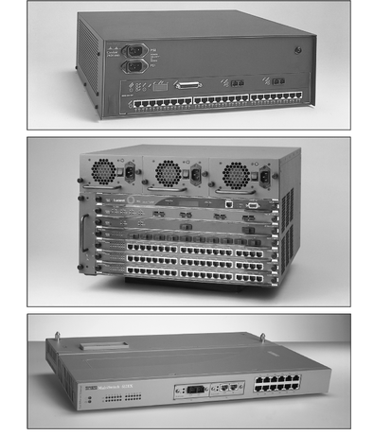
Switches
Subdivide a network into smaller logical pieces
A switch is a multiport bridge with a buffer designed that can boost its efficiency(a large number of ports imply less traffic) and performance.
A switch is a data link layer device.

Slide 38
A network switch fundamentally consists of three primary hardware components: Input/Output Ports, a Switching Fabric (which acts as the data plane), and a Routing Processor (which forms the control plane).
Together, they allow the switch to receive, process, and forward data across a local network.
A switch forwards data only to the port on which the destination system is connected.

Slide 39
The switch can perform error checking before forwarding data, which makes it very efficient as it does not forward packets that have errors and forward good packets selectively to the correct port only.
It looks at the Media Access Control (MAC) addresses of the devices connected to it to determine the correct port. A MAC address is a unique number that is stamped into every NIC.
By forwarding data only to the system to which the data is addressed, the switch decreases the amount of traffic on each network link dramatically.

Slide 40
Three methods to deal with data as it arrives:
Cut-through
  In a cut-through configuration, the switch begins to forward the packet as soon as it is received. i.e. switch reads a frame’s header and decides where to forward the data before it receives the entire packet.
  No error checking is performed on the packet, so the packet is moved through quickly. The downside of cut-through is that because the integrity of the packet is not checked, the switch can propagate errors.

Slide 41
Store and forward mode
  In a store-and-forward configuration, the switch waits to receive the entire packet before beginning to forward it. It also performs basic error checking. i.e. switch reads the entire data frame into its memory and checks it for accuracy before transmitting the information
Fragment-free—Building on the speed advantages of cut-through switching, fragment- free switching works by reading only the part of the packet that enables it to identify fragments of a transmission.

Slide 42
Full Duplex Switches
A full duplex switch allows for simultaneous transmission and reception of data to and from a workstation.
This full duplex connection helps to eliminate collisions.
To support a full duplex connection to a switch, two sets of wires are necessary - one for the receive operation and one for the transmit operation.

Slide 43
Routers
Multiport connectivity device
Can integrate LANs and WANs running at different transmission speeds and using a variety of protocols
Routers operate at the Network layer (Layer 3) of the OSI Model
A router accepts an outgoing packet, removes any LAN headers and trailers, and encapsulates the necessary WAN headers and trailers
Because a router has to make wide area network routing decisions, the router has to dig down into the network layer of the packet to retrieve the network destination address

Slide 44
Router Features and Functions
Filter out broadcast transmission to alleviate network congestion
Prevent certain types of traffic from getting to a network
Support simultaneous local and remote activity
Provide high network fault tolerance through redundant components
Monitor network traffic and report statistics to a Management Information Base (MIB)
Diagnose internal or other connectivity problems and trigger alarms
Routers often incorporate firewall functions

Slide 45
Functions of a Router
Forwarding: Receives packets, examines headers, and forwards them to the correct output port.
Routing: Determines the optimal path for packets using routing tables and algorithms.
Network Address Translation (NAT): Translates private IPs to a public IP for Internet access.
Security: Supports firewalls and other security measures.
VPN Connectivity: Provides secure remote access to networks.
Bandwidth Management: Controls data flow to prevent congestion.
Monitoring & Diagnostics: Tracks traffic and helps troubleshoot network issues.

Slide 46
Router and the OSI Model

Slide 47
Routers in an Internet

Slide 48
Brouters and Routing Switches
Bridge router
  Also called a brouter - Industry term used to describe routers that take on some characteristics of bridges
  a device which combines features of both bridge and router.
  It can work either at data link layer or at network layer.
  Working as router, it is capable of routing packets across networks; working as bridge, it is capable of filtering local area network traffic.
Routing switch
  Router hybrid that combines a router and a switch

Slide 49
WIRELESS ACCESS POINTS
An access point in networking is a device that allows wireless devices, like smartphones and laptops, to connect to a wired network.
It allows wireless end devices to connect to a wired or wireless network. It acts as a bridge between different types of networks or media.
It creates a Wi-Fi network that lets wireless devices communicate with the internet or other devices on the network.
Wireless Access points referred to as either WAPs or wireless Aps, are a transmitter and receiver (transceiver) device used for wireless LAN (WLAN) radio signals.
A WAP is typically a separate network device with built-in antenna, transmitter and adapter. They are commonly found in homes, offices, and public places to provide wireless internet access.

Slide 50
WAPs use the wireless infrastructure network mode to provide a connection point between WLANs and a wired Ethernet LAN.
WAPs also typically have several ports allowing a way to expand the network to support additional clients.
A WAP can operate as a bridge connecting a standard wired network to wireless devices or as a router passing data transmissions from one access point to another.
It also performs functions such as authentication, encryption, channel selection, etc.

Slide 51
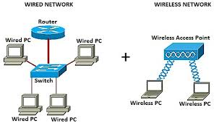

Slide 52
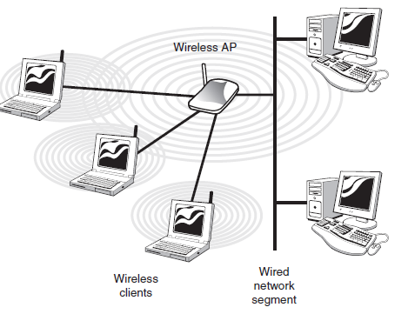

Slide 53
Depending on the size of the network, one or more WAPs may be required. Additional WAPs are used to allow access to more wireless clients and to expand the range of the wireless network.
Each WAP is limited by a transmissions range, the distance a client can be from a WAP and still get a useable signal.
The actual distance depends on the wireless standard being used and the obstructions and environmental conditions between the client and the WAP.

Slide 54
WAP receives transmissions from wireless devices within a specific range and transmits those signals to the network beyond.
This network may be a private Ethernet network or Internet. The transmission range a WAP can support and number of wireless device that can connect to it depends on the wireless standard being used and the signal interference between the two devices.
In infrastructure wireless networking, there may be multiple access points to cover a large area or only a single access point for a small area such as a single home or small building.

Slide 55
Gateways
Combination of networking hardware and software that connects two dissimilar kinds of networks
A gateway is a piece of networking hardware used in telecommunications for telecommunications networks that allows data to flow from one discrete network to another.
Popular types of gateways include:
  E-mail gateways
  IBM host gateways
  Internet gateways
  LAN gateways

Slide 56
A gateway is often characterized as being the combination of a router and a modem.
Gateways are basically protocol converters, facilitating compatibility between two protocols and operating on any layer of the open systems interconnection (OSI) model.

Slide 57
Gateway and the OSI Model

Slide 58
A Gateway

Slide 59
Types of gateways
Gateways can take several forms and perform a variety of tasks. Examples of this include:
Web application firewalls- This type filters traffic to and from a web server and looks at application-layer data.
Cloud storage gateways- This type translates storage requests with various cloud storage service API calls. It allows organizations to integrate storage from a private cloud into applications without migrating into a public cloud.
API, SOAor XML gateways – This type manages traffic flowing into and out of a service, microservices-oriented architecture or XML-based web service.

Slide 60
IoT gateways-This type aggregates sensor data from devices in an IoT environment, translates between sensor protocols and processes sensor data before sending it onward.
Media gateways- This type converts data from the format required for one type of network to the format required for another.
Email security gateways- This type prevents the transmission of emails that break company policy or will transfer information with malicious intent.
VoIP trunk gateways- This type facilitates the use of plain old telephone service equipment, such as landline phones and fax machines, with a voice over IP (VoIP) network.

Slide 61
Gateways and routers
Gateways are distinct from routers or switches in that they communicate using more than one protocol and can operate at any of the seven layers of the open systems interconnection model (OSI)
Gateways and routers are similar in that they both can be used to regulate traffic between two or more separate networks.
However, a router is used to join two similar types of networks and a gateway is used to join two dissimilar networks.
Dissimilar could be used to describe networks that use different primary protocols.

